Slide 1

Diamond price prediction
Link : https://www.kaggle.com/karnikakapoor/diamond-price-prediction
Dataset : diamonds.csv

Slide 2
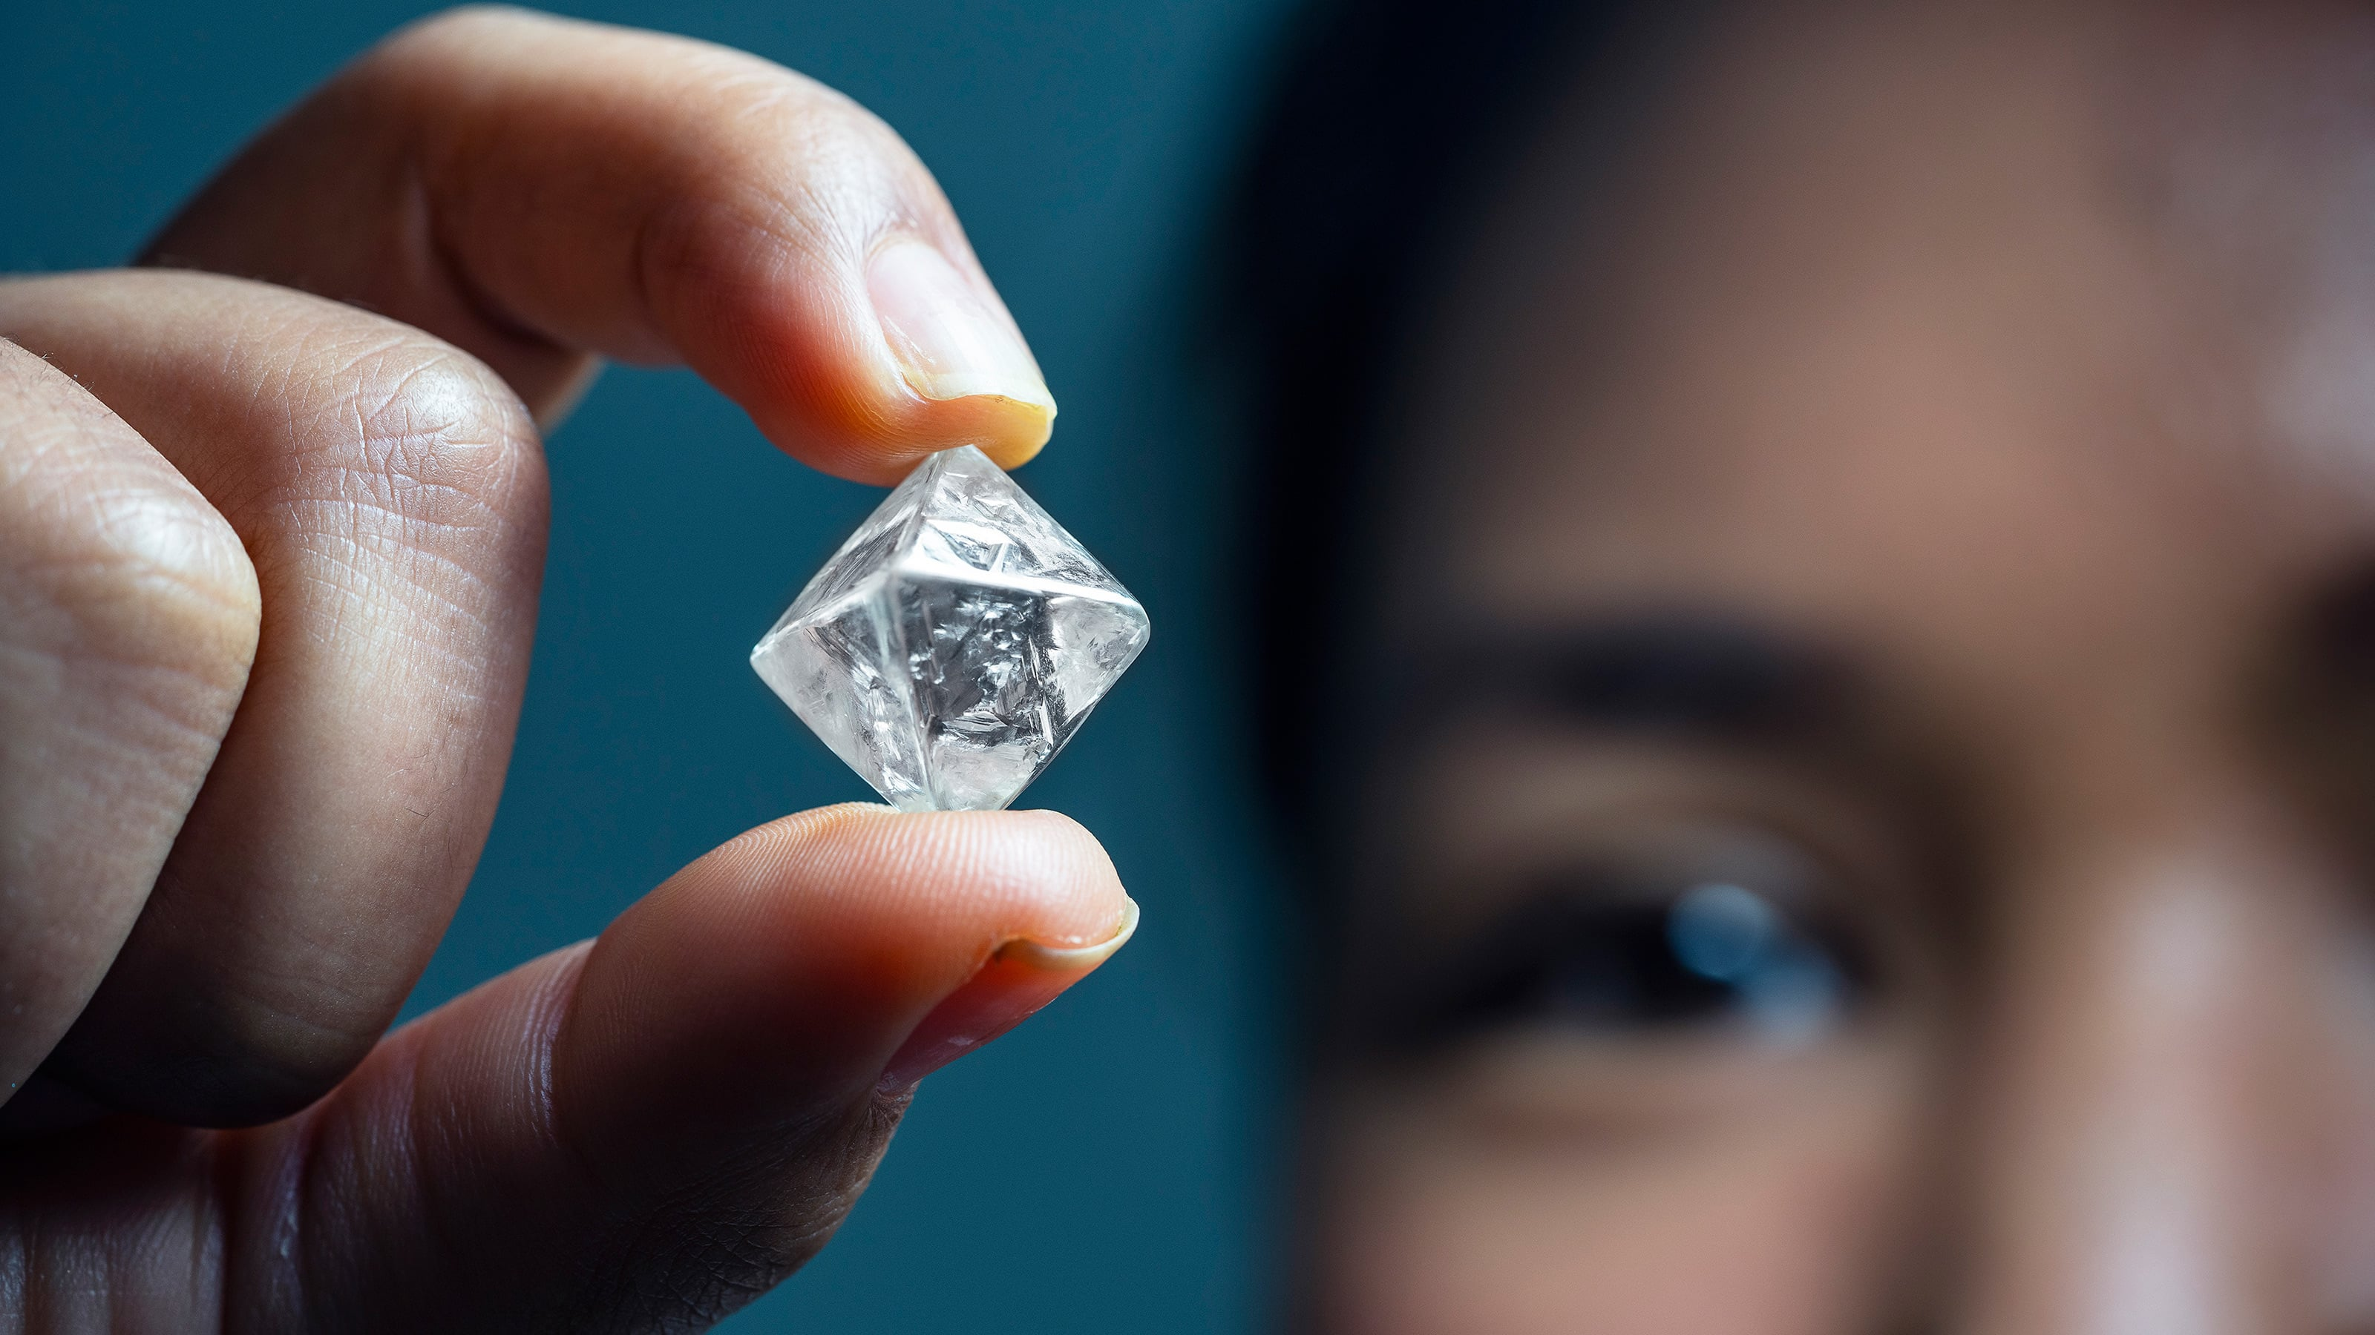

GOAL :
Analyze diamonds by their cut, color, clarity, price, and other attributes. This classic dataset contains the prices and other attributes of almost 54,000 diamonds.

Slide 3
MY LEARNING :
Concept of Bagging
Algorithms based on bagging
Model Building – Decision tree, Random forest
Random forest using Grid Search
Random forest using Random Search

Slide 4
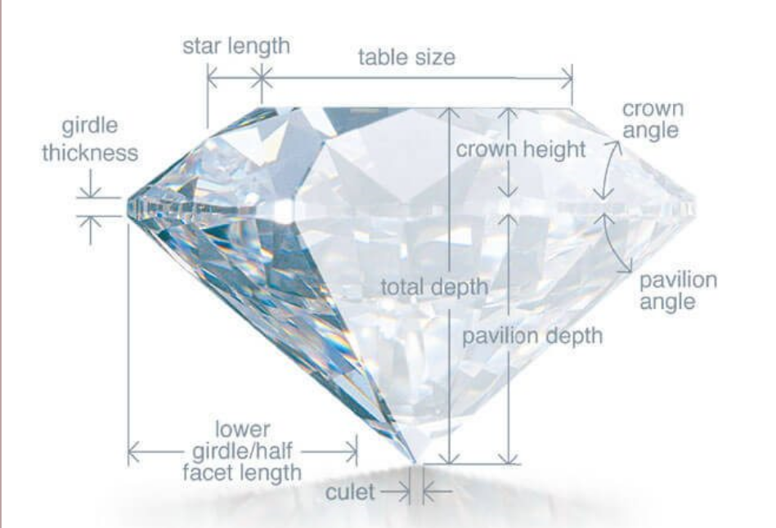
VARIABLES INVOLVED :
Price : price in US dollars (\$326--\$18,823)
carat : weight of the diamond (0.2--5.01)
cut :quality of the cut (Fair, Good, Very Good, Premium, Ideal)
Color : diamond color, from J (worst) to D (best)
table : width of top of diamond relative to widest point (43--95)

Slide 5
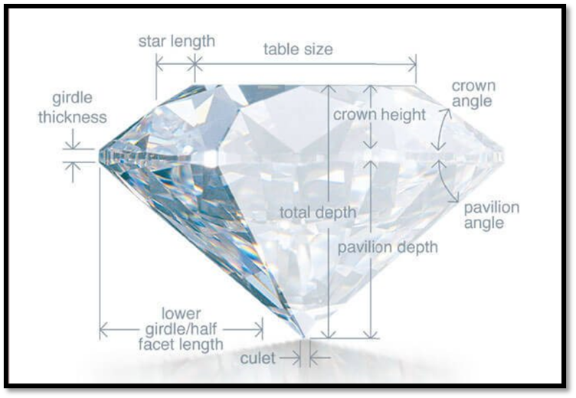
VARIABLES INVOLVED :
clarity a measurement of how clear the diamond is (I1 (worst), SI2, SI1, VS2, VS1, VVS2, VVS1, IF (best))
x length in mm (0--10.74)
y width in mm (0--58.9)
z depth in mm (0--31.8)
depth total depth percentage =
z / mean(x, y) = 2 * z / (x + y) (43--79)

Slide 6
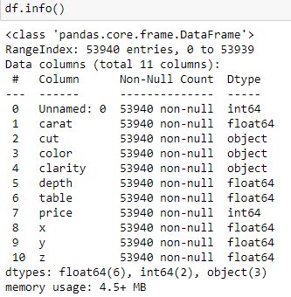
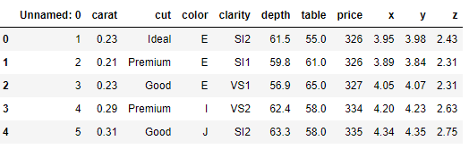
DATASET :

Slide 7
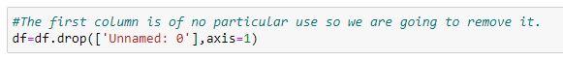
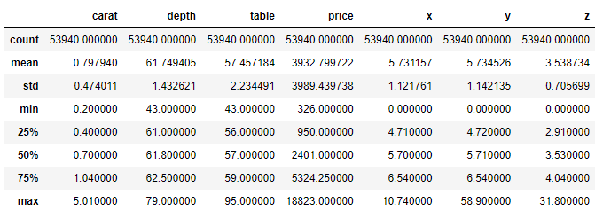
DATA MANIPULATION :

Slide 8
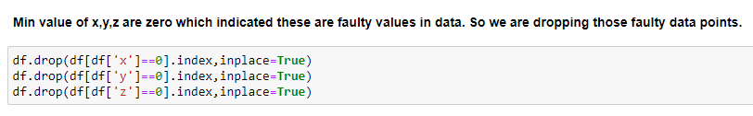
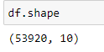
DATA MANIPULATION :

Slide 9
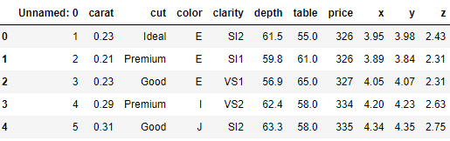
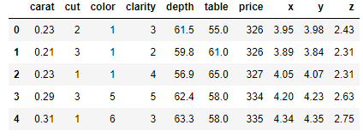
DATA MANIPULATION :
Label encoding:
Label Encoding
BEFORE LABEL ENCODING
AFTER LABEL ENCODING

Slide 10
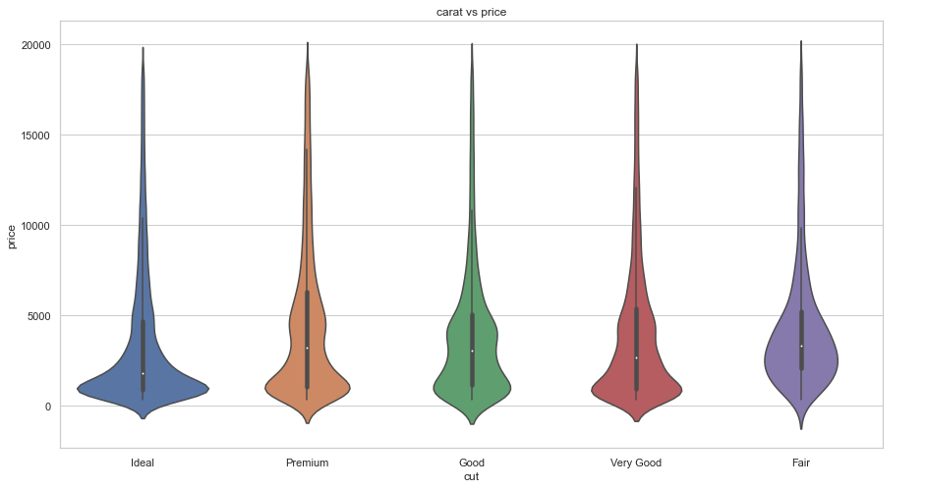
EDA :
Cut type- Even Ideal cut type diamonds are high in the dataset, it doesn't have high price in total.
Cut type- Even Fair diamonds are least in the dataset, it secures 2nd position in total price distribution of cut category.
Cut type- Premium cut type diamonds in the dataset have high price in total.
cut vs price

Slide 11
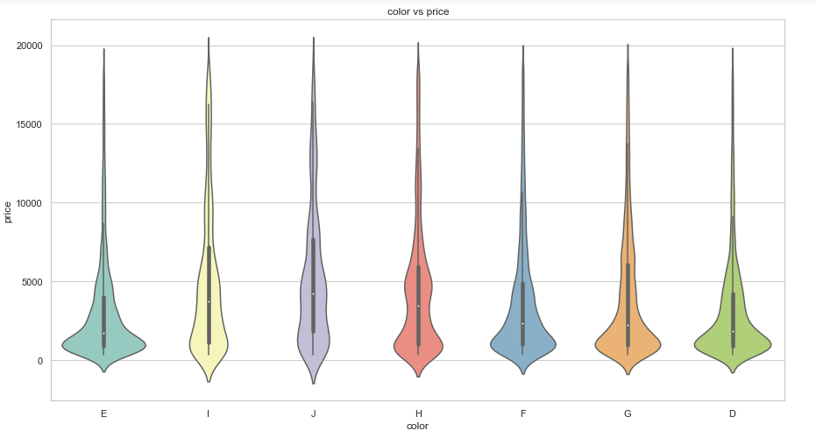
color vs price
Color type- J type has least in number of diamonds in dataset, but it has high price in total price distribution.
Color type- G type are maximum in number in dataset but it does not have high price in total price distribution in the dataset.

Slide 12
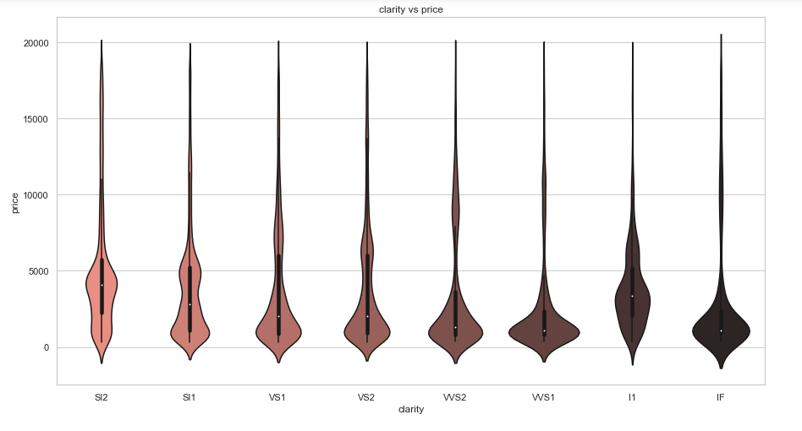
clarity vs price
Clarity type- L1 diamonds are least in number in the dataset but it considerably has high price in total price distribution of clarity type diamonds.
Clarity type- Sl1 diamonds are maximum in the dataset but it doesn't have high price in total price distribution of clarity type diamonds.

Slide 13
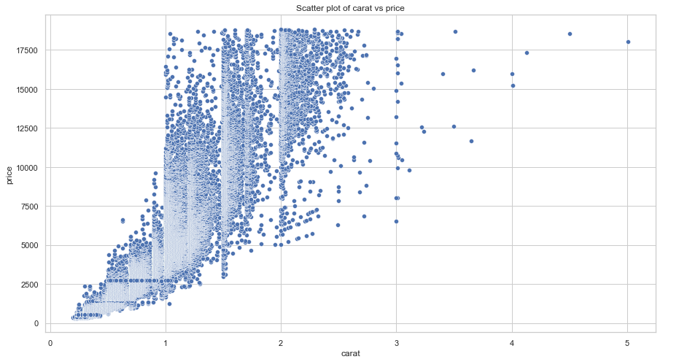
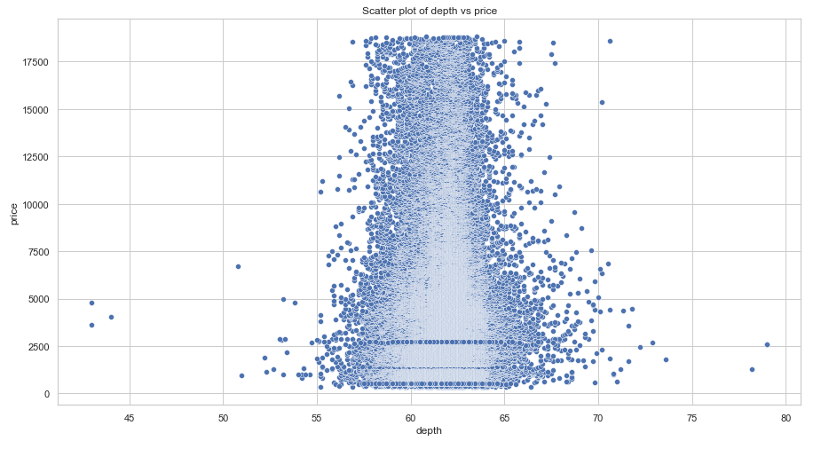
carat vs price
depth vs price

Slide 14
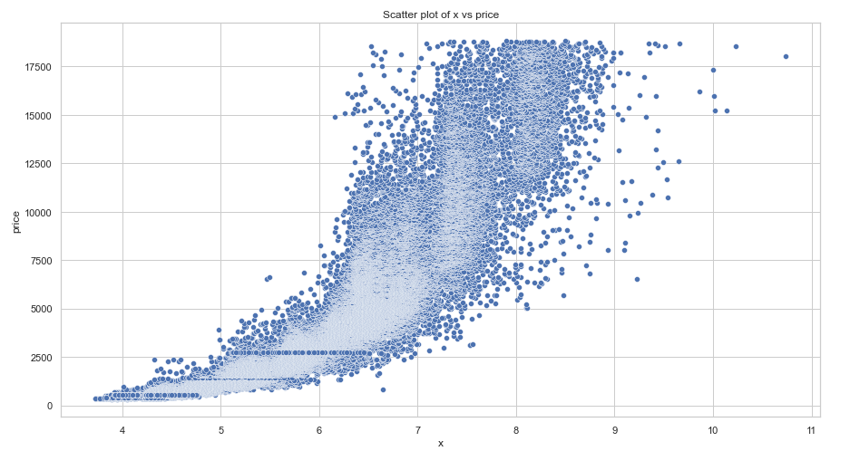
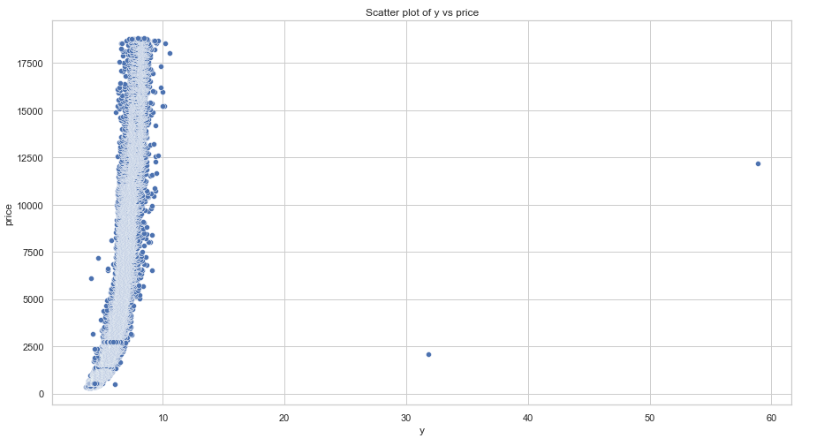
x vs price
y vs price

Slide 15
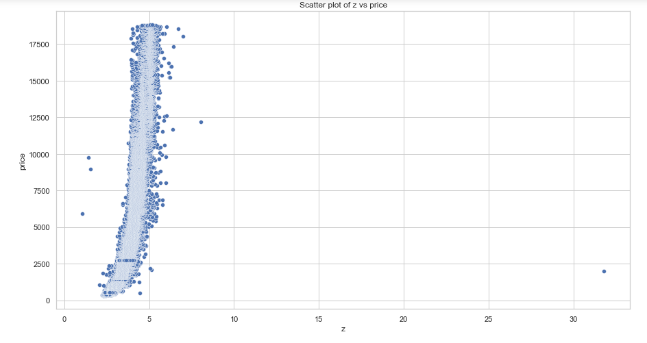
z vs price
Takeaways from plots:
There is some sought of good linear relationship between x,y,z,carat and price variables

Slide 16
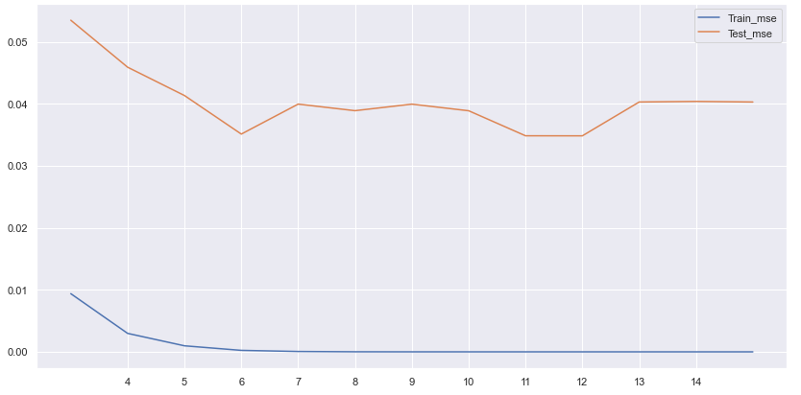
MODEL BUILDING : MODEL 1 :
DECISION TREE
Finding the optimum number of depth :
Minimum mse
Difference between train_mse and test_mse is minimum seen in depth 6.

Slide 17
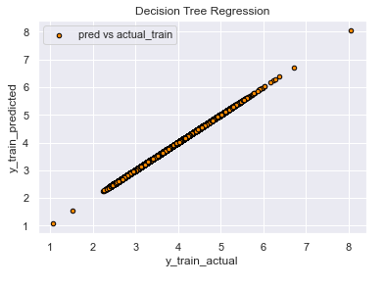
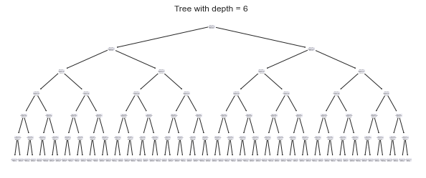
DECISION TREE
RMSE OF TRAIN DATA: 1.0571141460751503e-14
RMSE OF TEST DATA : 0.2007584

Slide 18
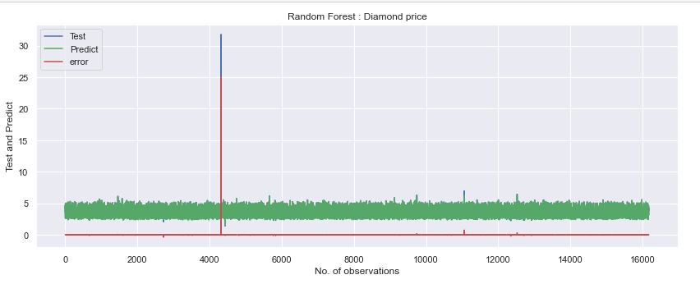
MODEL 2 :
RANDOM FOREST
RMSE OF RANDOM FOREST : 0.1978

Slide 19
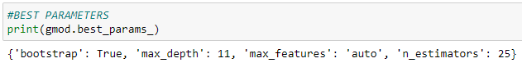
MODEL 3 :
RANDOM FOREST (USING GRID SEARCH)
RMSE OF RANDOM FOREST USING GRID SEARCH : 0.19644

Slide 20
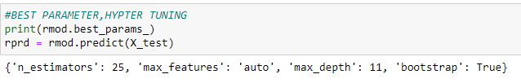
MODEL 4 :
RANDOM FOREST (USING RANDOM SEARCH)
RMSE OF RANDOM FOREST USING RANDOM SEARCH : 0.19644

Slide 21
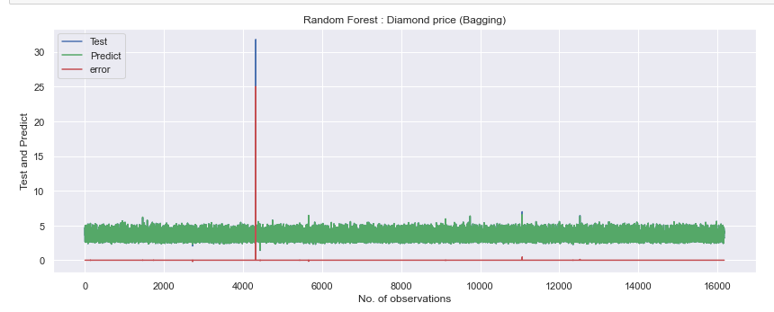
MODEL 5 :
BAGGING – 300 TREES
RMSE OF BAGGING : 0.1967

Slide 22

THANKS FOR VIEWING MY WORK!

